Slide 1
Interprofessional Education (IPE) Outbreak Experience – Facilitator Instructions for Remote Synchronous Delivery
YOUR COLLEGE / UNIVERSITY NAME
IPE FACULTY NAMES

Slide 2
Thank You!
Your participation in this activity enhances the experience and provides valuable insights to the student!
This couldn’t happen without you!

Slide 3
Overview
This exercise simulates an Infectious Disease Outbreak.
This is an educational activity that places public health and health professions students in the role of interacting as a member of a multidisciplinary unified response team, requiring that they engage in effective teamwork as they collaborate in decision-making and communication in response to the rising threat of an infectious disease outbreak.

Slide 4
Overview, Continued
This outbreak activity enhances existing education in community resilience and preparedness, health equity and social justice in several ways:
Participants take on roles in the unified command response, rather than in patient triage and treatment, which is typical in most IPE activities. This structure allows all students to have a better sense of the factors at play in strategic planning and decision-making in emergency preparedness and response.
This activity is designed so that the public health students take the lead on the team, which is typically the situation in emergency planning and response, but not typical in other IPE activities where the medical students often take the lead. This aspect of the activity highlights the important role that public health professionals play in community health and wellbeing.

Slide 5
Overview, Continued
This activity includes students and faculty from clinical mental health counseling, to address the importance of community and healthcare worker resilience in public health emergencies. Mental health professionals are often left out of the planning and response, and students in mental health counseling are rarely, if ever, included in emergency preparedness and response training.
This activity incorporates a health equity lens so that students can gain a better understanding of how community-level emergencies often affect citizens disproportionately, and how planning for equitable resource allocation can help address these disparities.

Slide 6
Logistics for Remote Synchronous Event
If the event is hosted, online facilitators must pre-register for 2 online meeting rooms to accommodate breakout sessions, the week prior to the event
ROOM 1 Online Link / Registration: [LINK] ROOM 2 Online Link / Registration: [LINK]
Post-registration confirmation email will be sent containing information about joining the meeting.
Join the event using the ROOM 1 link. Online meeting room will open at XX time. Event begins promptly at XX time and ends at XX time.

Slide 7
Logistics for In-Person Event
Facilitators need to register for the event at: (LINK)
Facilitators may be assigned to a room or group(s) of students

Slide 8
Facilitator Guide
A detailed Facilitator Guide is provided which contains the following:
Outbreak scenario
Description of the roles that students will be playing
Schedule
Student questions/prompts with examples of desired responses

Slide 9
Facilitator Reference
List of the timed actions that facilitators will need to do (for remote synchronous delivery)
Web address links needed for sharing videos and images with your team
The Jefferson Teamwork Observation Guide (JTOG) link - each facilitator will complete this short form during the final large group debriefing
Note: Blue text indicates actions for the facilitators.

Slide 10
Facilitator Roles
During remote synchronous delivery, facilitators will be in breakout rooms with interdisciplinary student groups.
Students will receive questions to discuss as a group. Help guide the student discussion.
Ensure students from different disciplines contribute to the discussion.
Add thought provoking questions.
Monitor the time spent on questions.

Slide 11
Facilitator Roles
Prompt students to talk, rather than providing the answers/ information to them. The goal is to have the students work and think through the experience.
Facilitators may need to share video or other content with students. In remote synchronous delivery, facilitators will receive notice in the breakout room – message will pop up at top of screen.
Open any timed videos and/or images using the links provided in the Virtual Facilitator Reference document, and share this content so that everyone can watch/view together.

Slide 12
Sharing Video-for Remote Event
Optimize video & audio (so students can both see and hear it). See below for Zoom™ example.
If sharing does not work, have students view on their own – share link in chat area

Slide 13
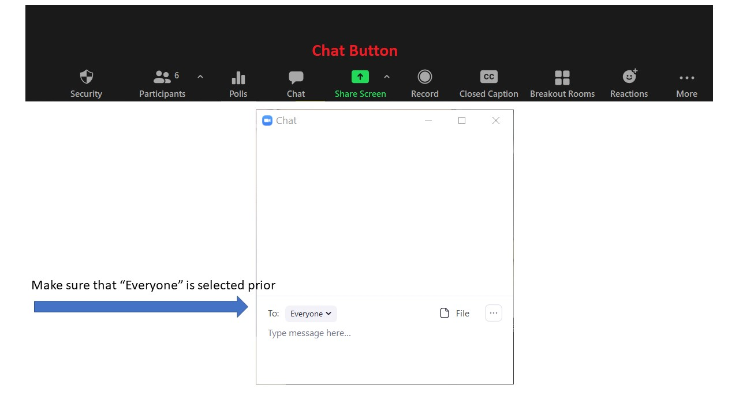
Online Chat
If link shared for individual viewing, set Chat to Everyone, and ask them to mute to avoid feedback

Slide 14
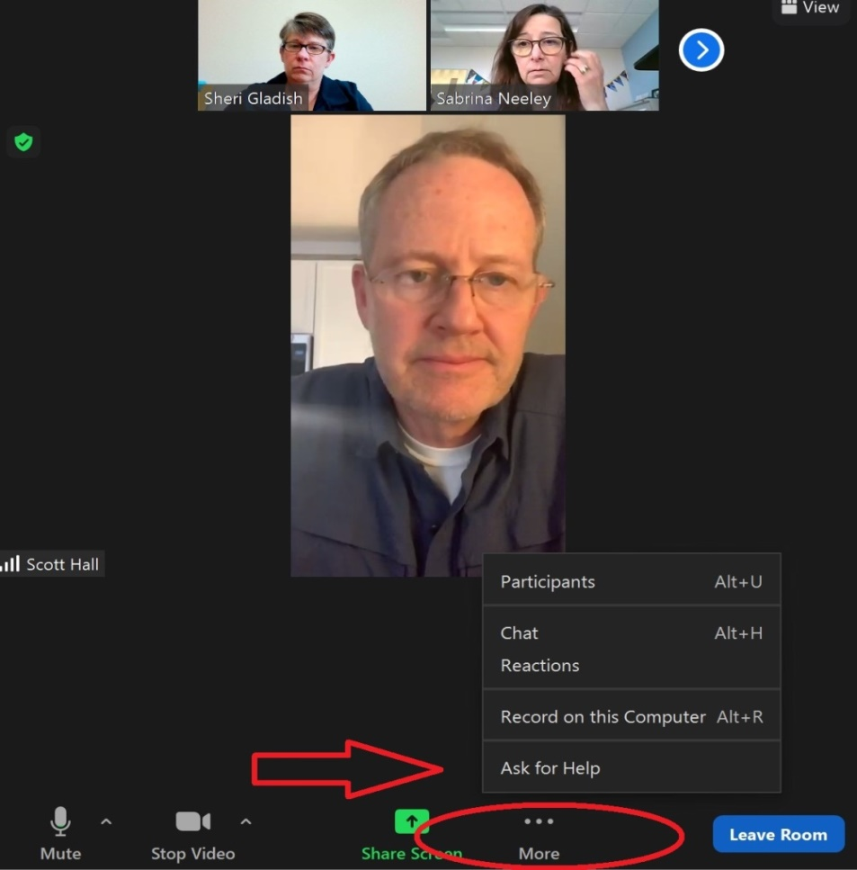
Help or Technical Assistance for Online Events
If help or technical assistance is needed, use the ‘Ask for Help’ option

Slide 15
Jefferson Teamwork Observation Guide (JTOG)
Short, 14-item Likert-scale tool to rate team behavior.
Each facilitator will observe team behavior and fill out the JTOG form at the end of the event, if desired by course Instructor
JTOG link will be provided by course Instructor

Slide 16
Thank You!
We appreciate your commitment to facilitate and participate in this learning opportunity!
If you have any questions please reach out to your event planning team.

